Slide 1
Introduction
We developed 2 different projects, being the first one a java Restful API and the second an angular project to consume the service;
Our application is based on the Express Entry Rating System. The API is responsible to return scores based on candidate profiles.
We developed the system using the hottest Java technologies and frameworks.

Slide 2

Back-End

Slide 3
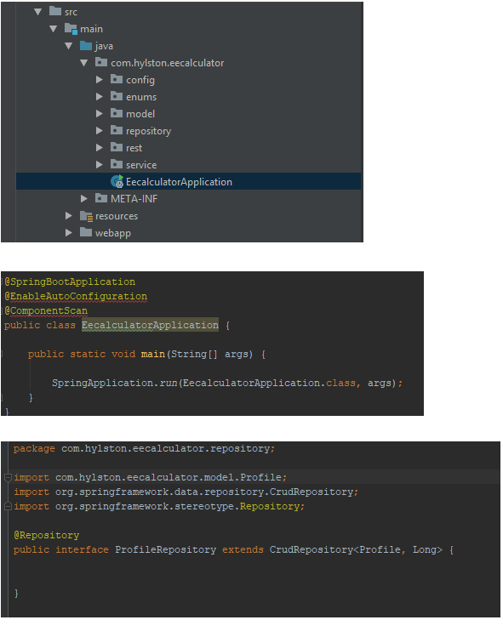

Slide 4
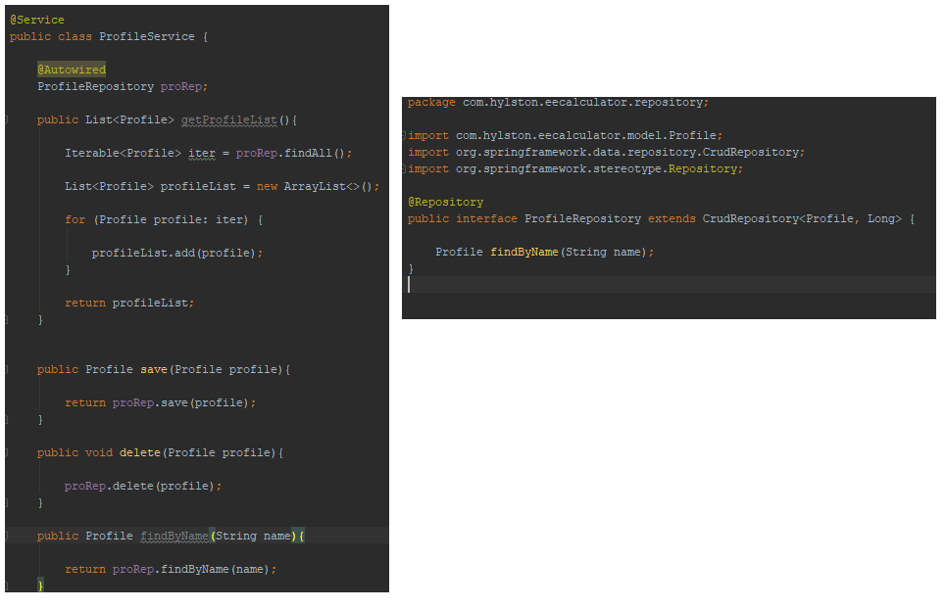

Slide 5
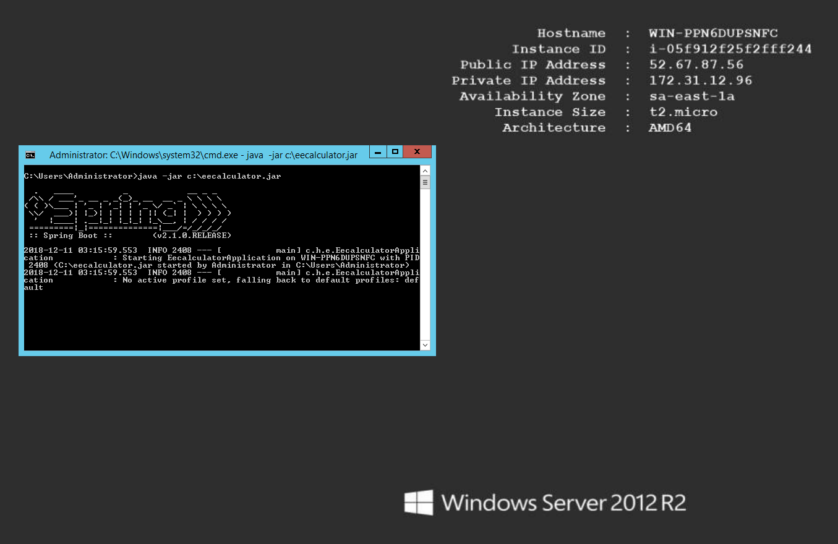
Deploy a Spring Application

Slide 6


Slide 7
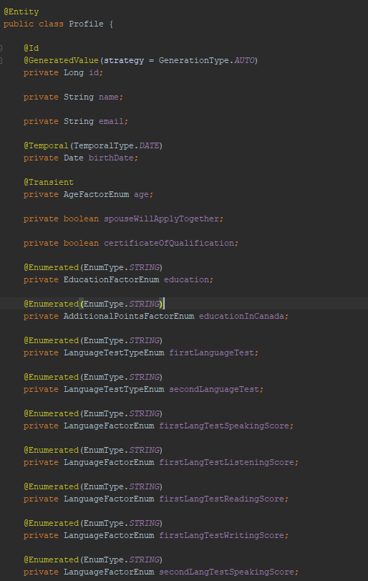
How to annotate an Entity

Slide 8
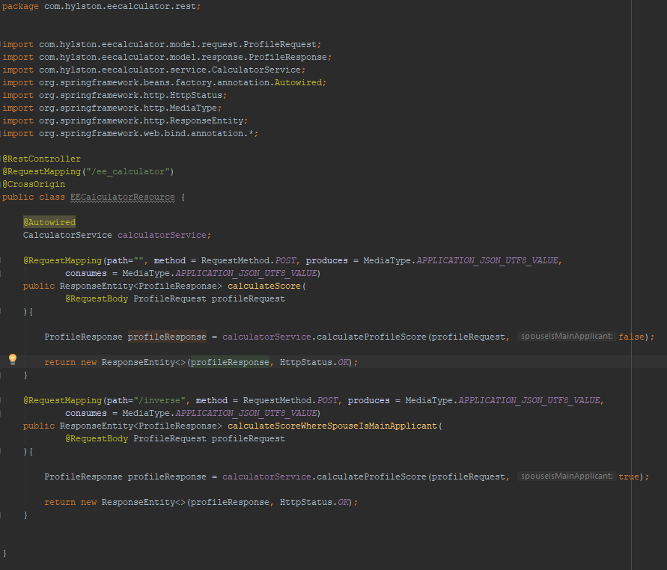
Rest Controller Class

Slide 9
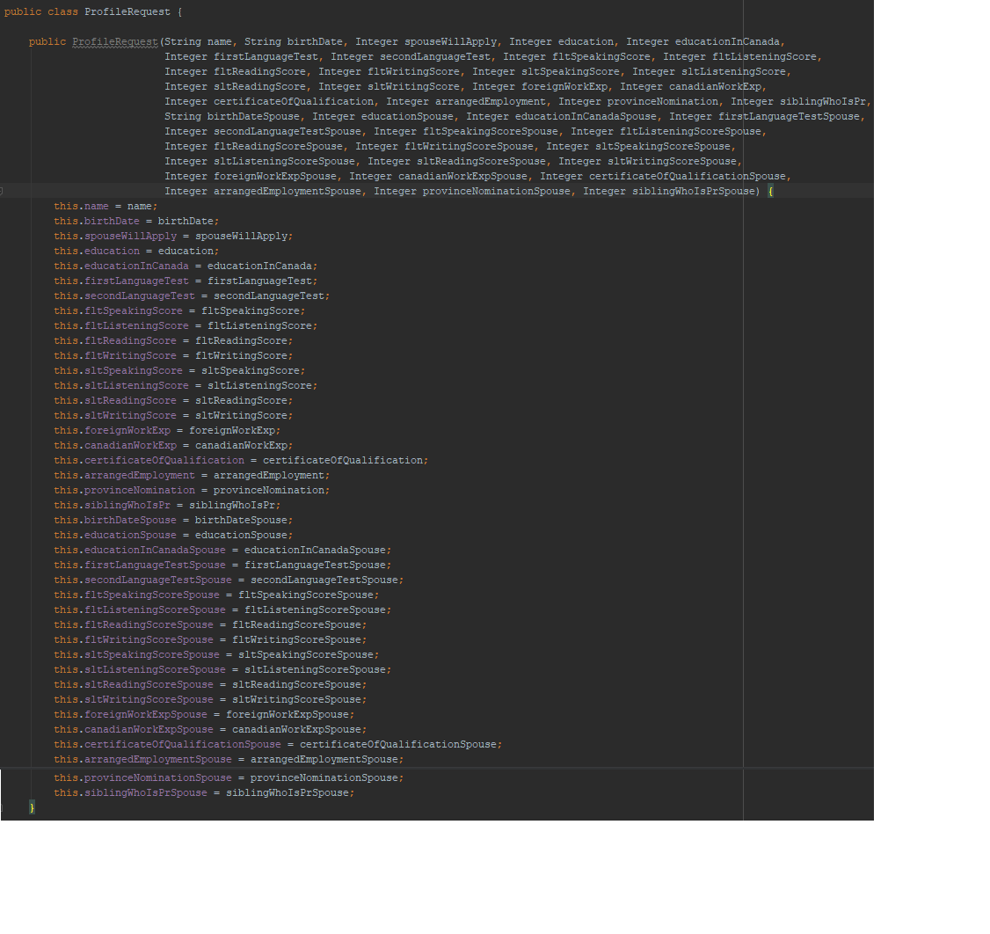
How to get the params

Slide 10

Tool to work with APIs

Slide 11
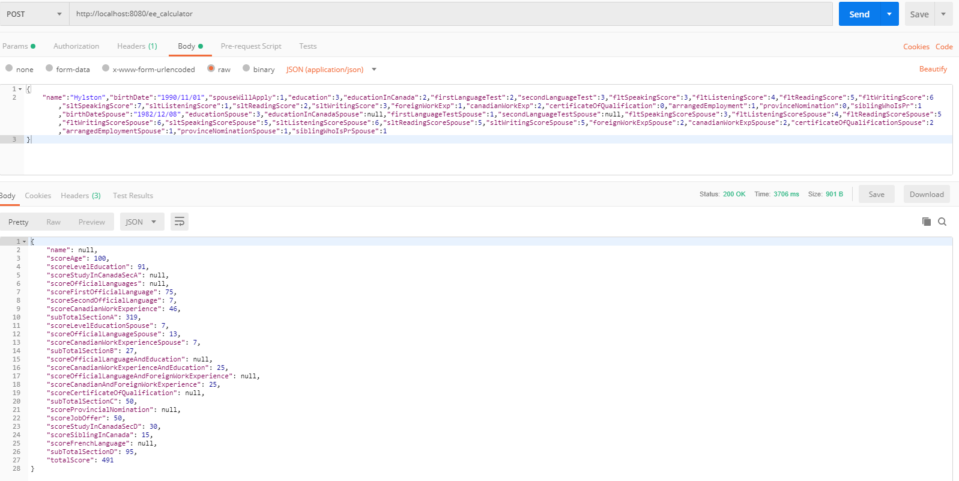
Using Postman – Post Request

Slide 12
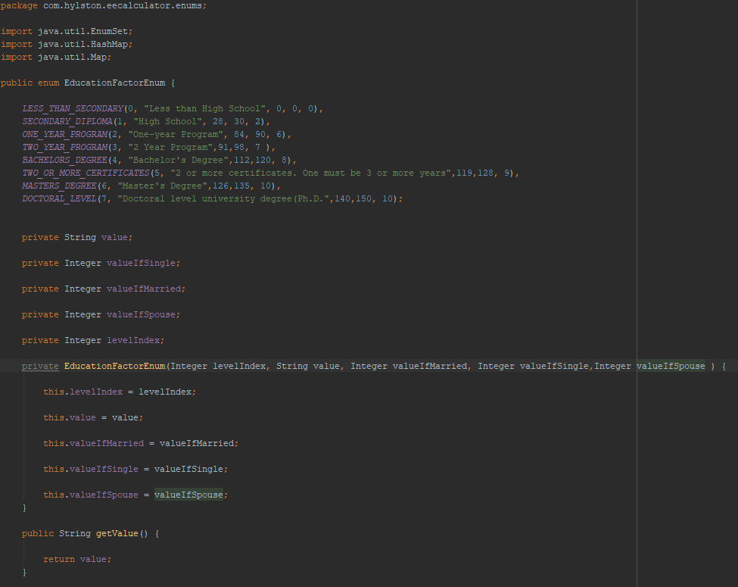
Example of Enum in Java

Slide 13

Front-End

